Slide 1
Dataset View – shows training images.

Slide 2
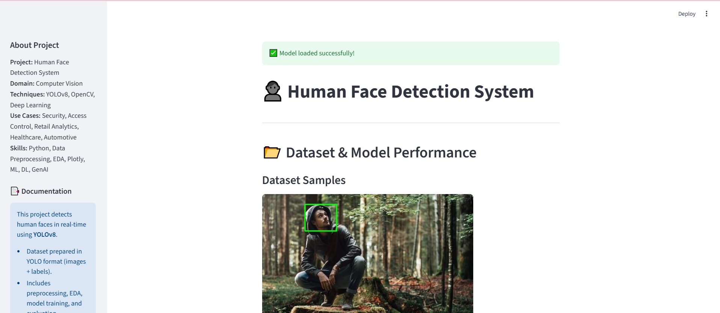

Slide 3


Slide 4
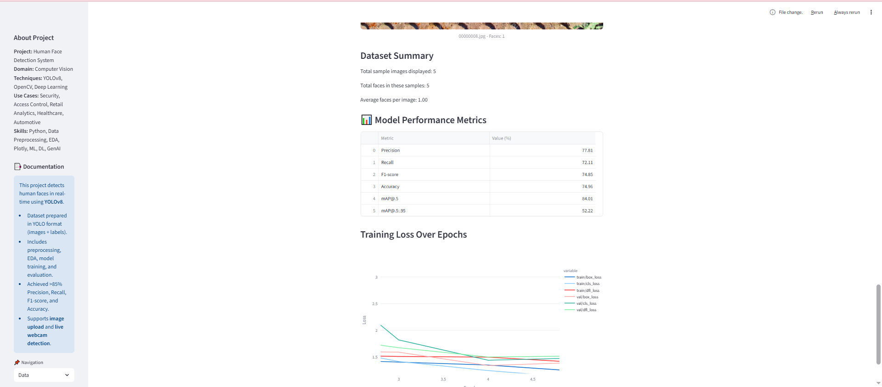

Slide 5
EDA Plots – class distribution, bounding box analysis.

Slide 6
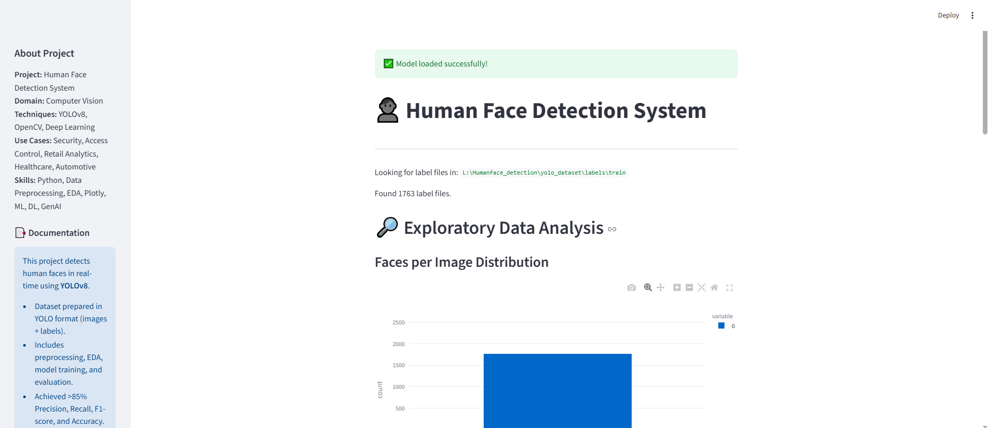

Slide 7
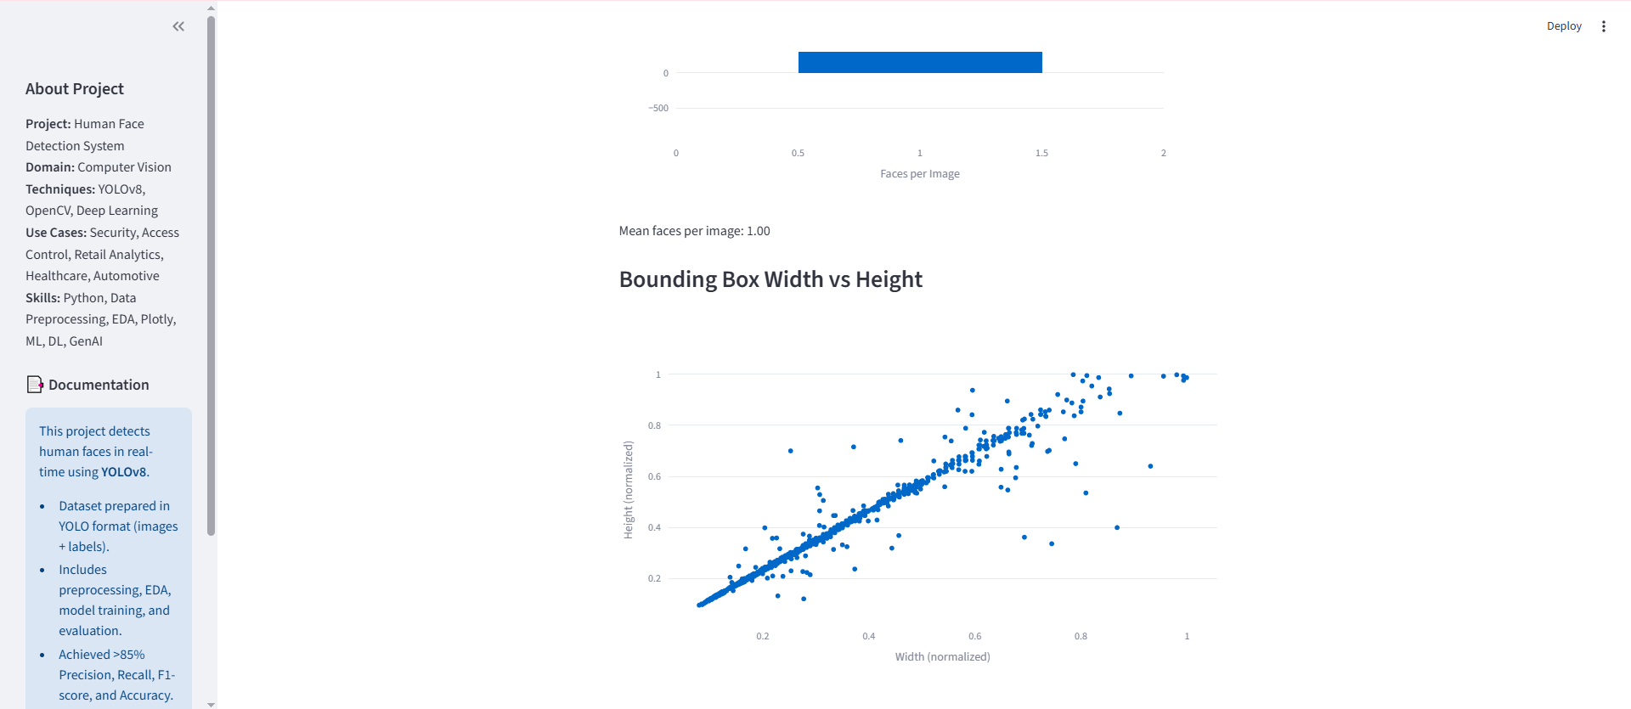

Slide 8
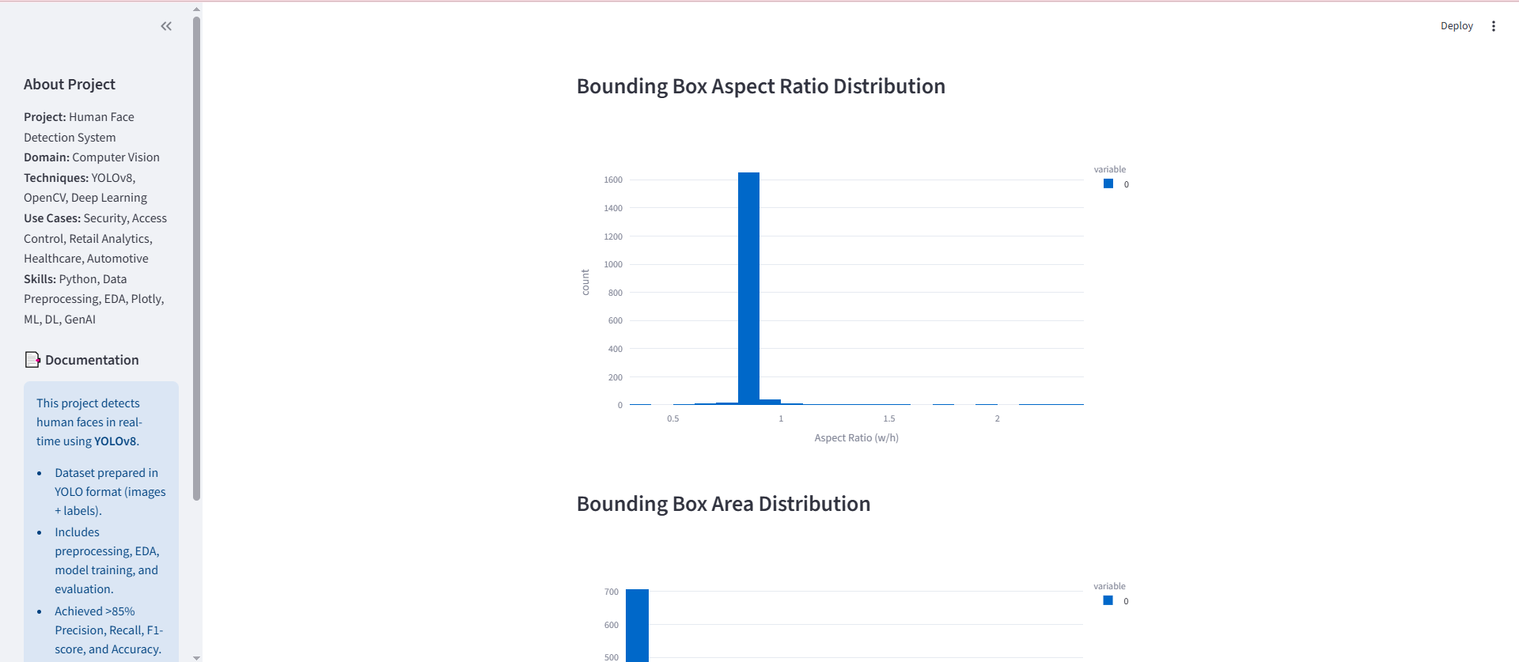

Slide 9
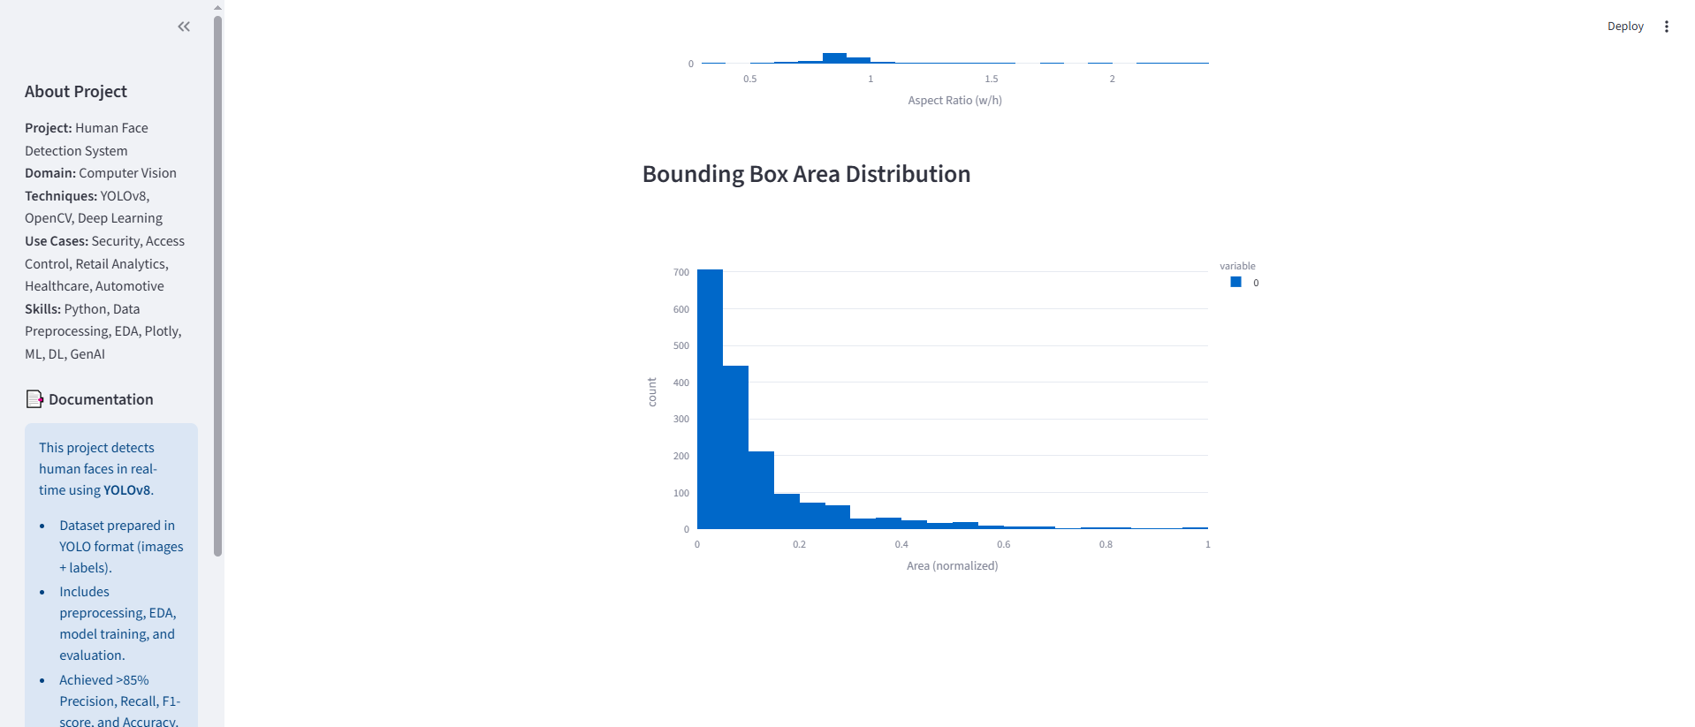

Slide 10
Prediction – face detection on uploaded images/videos.

Slide 11
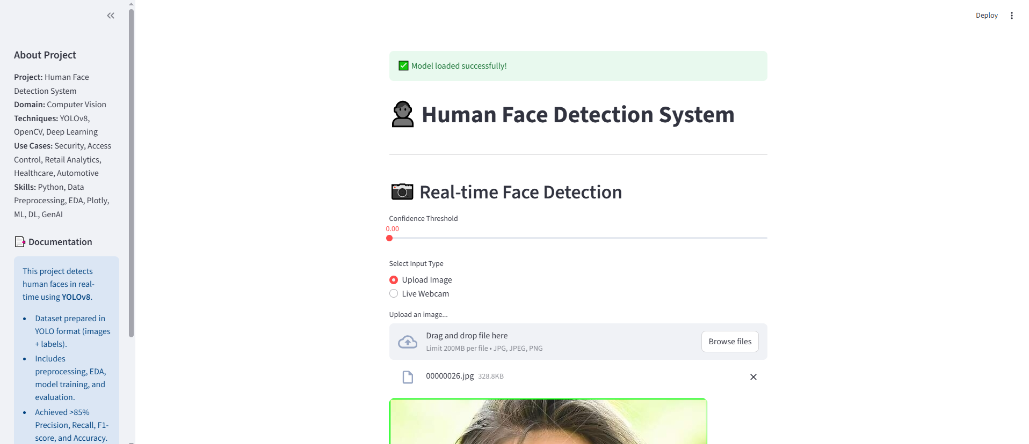

Slide 12
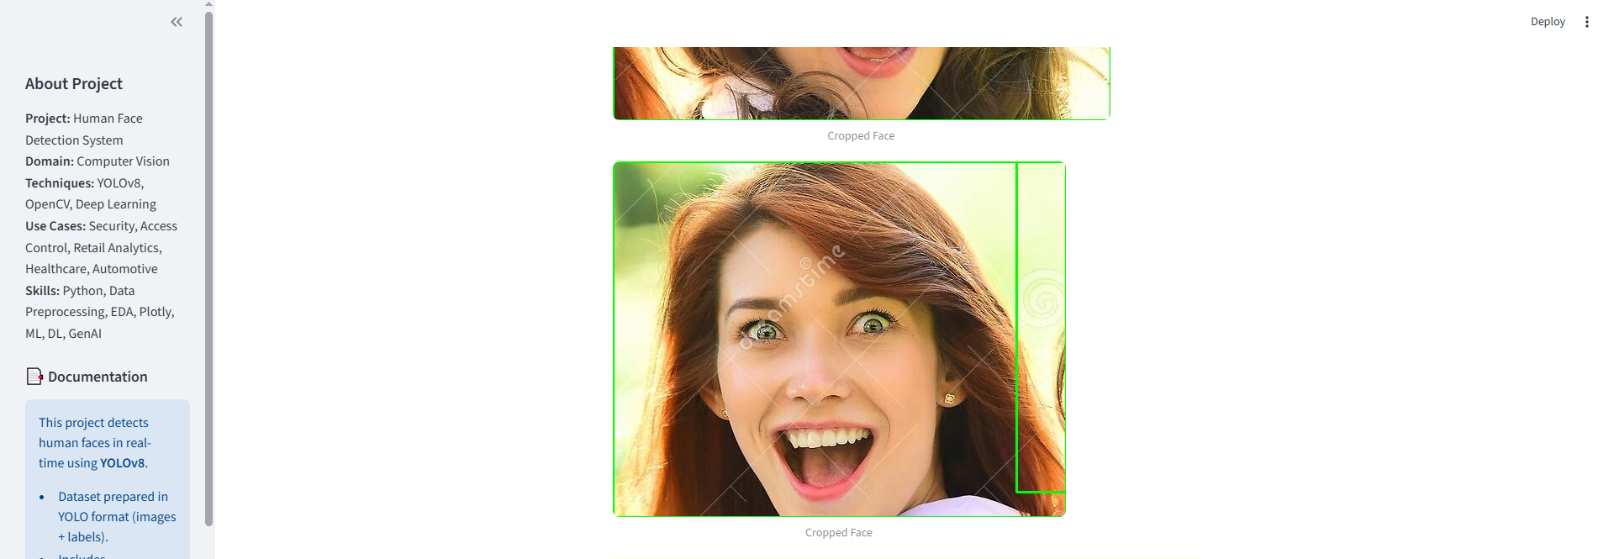

Slide 13
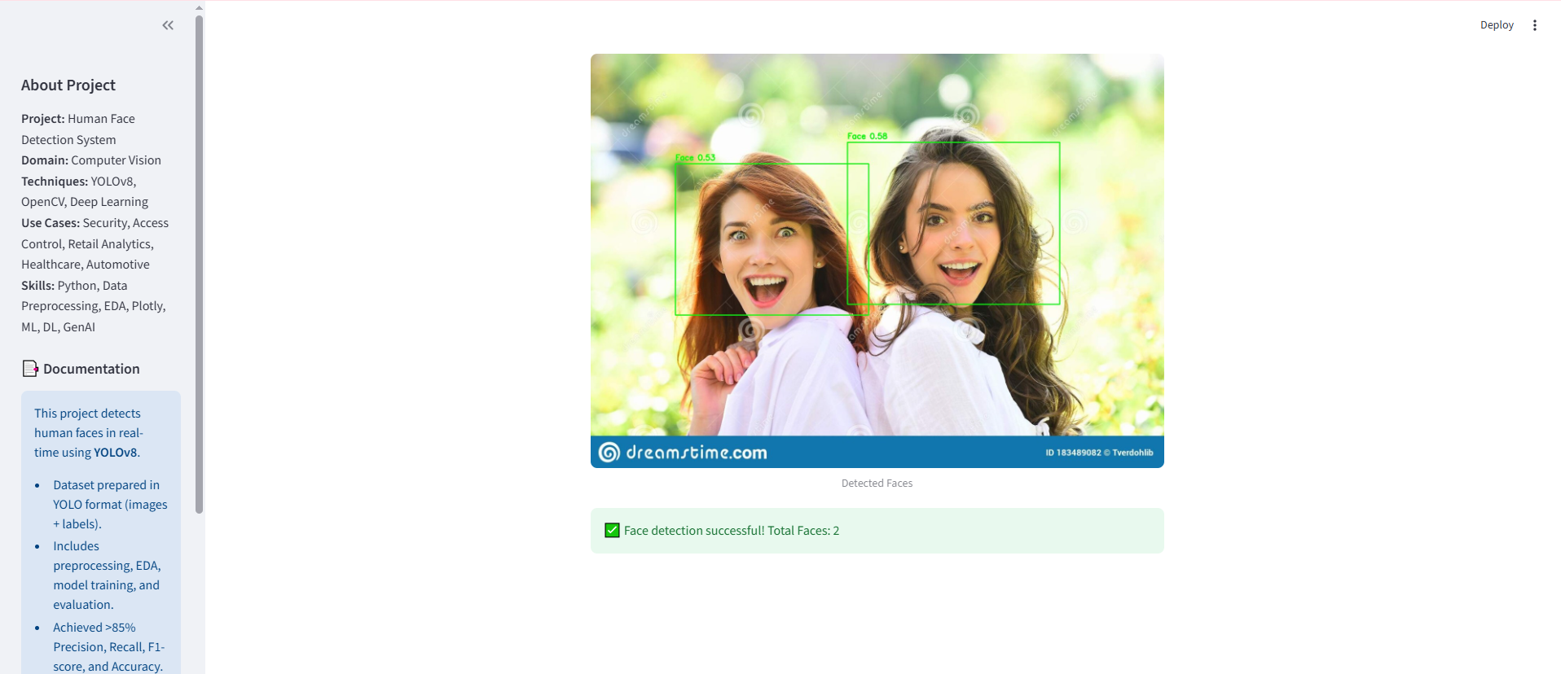

Slide 14
Webcam Mode – live real-time detection.

Slide 15
